Slide 1

Linux Control Groups

Slide 2
Main idea
Cgroups allow you to allocate resources
CPU time, system memory, network bandwidth, or combinations
Dynamically reconfigure on a running system
Control over allocating, prioritizing, denying, managing, and monitoring system resources

Slide 3
Main idea
Hierarchical Model
Linux process：init
Java class：Object
Cgroups

Slide 4
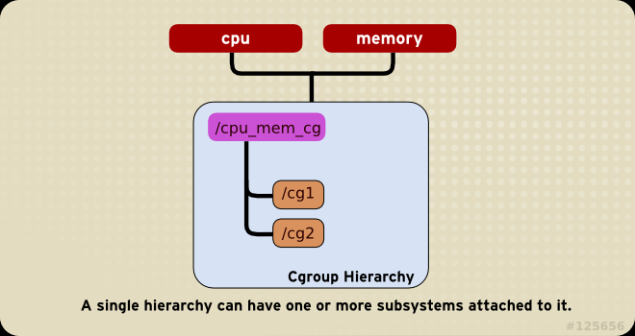
Main idea
Subsystem：a single resource
Hierarchy：a cgroups tree
Cgroups：a task set

Slide 5
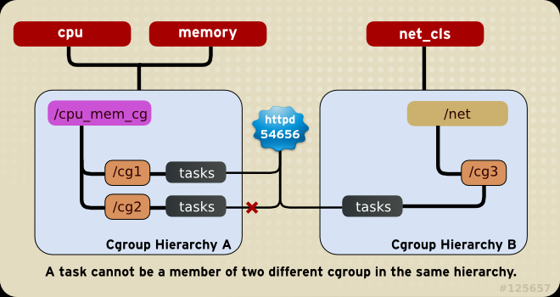
Main idea

Slide 6
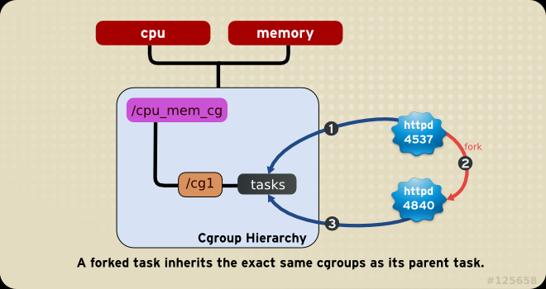
Main idea

Slide 7
blkio
controls and monitors access to I/O on block devices by tasks in cgroups
two policies for controlling access to I/O:
Proportional weight division: CFQ,set weights (percent) to specific cgroups
parameters:
blkio.weight: echo 500 > blkio.weight
blkio.weight_device: echo 8:0 500 > blkio.weight_device
I/O throttling (Upper limit): set an upper limit for the number of I/O operations performed by a specific device.
Notes:
块I/O (blkio)子系统通过cgroups中的任务控制和监视对块设备的I/O访问。向其中一些伪文件写入值会限制访问或带宽，从其中一些伪文件读取值可以提供有关I/O操作的信息。
Proportional weight division: 在完全公平排队(CFQ) I/O调度程序中实现，这个策略允许你设置特定的cgroup的权重。这意味着每个cgroup都有一个保留的所有I/O操作的设置百分比(取决于cgroup的权重)。
I/O throttling (Upper limit) :该策略用于设置指定设备执行I/O操作的上限。这意味着一个设备可以有一个有限的读写操作速率。
blkio.weight:指定cgroup默认可访问块I/O的相对比例(weight)，范围为100 ~ 1000。blkio会覆盖特定设备的blkio.weight_device参数
blkio。weight_device指定cgroup可使用的特定设备上I/O访问的相对比例(权重)，范围从100到1000。该参数的值覆盖blkio.weight。指定设备的重量参数。
取值的格式为major:minor weight，其中major和minor表示“Linux已分配设备”中指定的设备类型和节点编号，也称为“Linux设备列表

Slide 8
blkio
two policies for controlling access to I/O:
I/O throttling (Upper limit):
blkio.throttle.read_bps_device: upper limit on the number of read operations a device
echo "8:0 10485760" > /cgroup/blkio/test/blkio.throttle.read_bps_device
blkio.throttle.write_bps_device: upper limit on the number of write operations a device
echo "8:0 10485760" > /cgroup/blkio/test/blkio.throttle.write_bps_device
blkio.throttle.write_iops_device:
echo "8:0 10" > /cgroup/blkio/test/blkio.throttle.write_iops_device
blkio.throttle.read_iops_device:
echo "8:0 10" > /cgroup/blkio/test/blkio.throttle.read_iops_device
blkio.throttle.io_serviced: read, write, sync, or async
blkio.throttle.io_service_bytes: not updated when the CFQ scheduler is operating; bytes
Notes:
blkio.throttle.read_bps_device:指定设备可执行的读操作的上限。读取操作的速率以每秒字节为单位指定。条目有三个字段:major、minor和bytes_per_second。“Major”和“minor”是“Linux Allocated Devices”中指定的设备类型和节点编号，“bytes_per_second”是可执行读操作的最大速率 8:0 => /dev/sda
blkio.throttle.write_bps_device: 指定设备可执行的写操作的上限。写操作的速率以每秒字节为单位指定。条目有三个字段:major、minor和bytes_per_second。“Major”和“minor”是“Linux Allocated Devices”中指定的设备类型和节点编号，“bytes_per_second”是可执行写操作的最大速率
blkio.throttle.write_iops_device: 指定设备可执行的写操作的上限。写操作速率以“每秒操作数”为单位。条目有三个字段:major、minor和operations_per_second。“Major”和“minor”为“Linux已分配设备”中指定的设备类型和节点编号，“operations_per_second”为可执行写操作的最大速率。
blkio.throttle.read_iops_device: 指定设备可执行的读操作的上限。读取操作的速率以每秒的操作数来指定。条目有三个字段:major、minor和operations_per_second。“Major”和“minor”为“Linux已分配设备”中指定的设备类型和节点编号，“operations_per_second”为可执行读操作的最大速率。
blkio.throttle.io_serviced: 报告通过节流策略看到的cgroup在特定设备上执行的I/O操作数。条目有四个字段:major、minor、operation和number。Major和minor表示“Linux分配设备”中指定的设备类型和节点号，operation表示操作类型(读、写、同步、异步)，number表示操作次数。
blkio.throttle.io_service_bytes:

Slide 9
cpu
schedules CPU access to cgroups
two schedulers:
Completely Fair Scheduler (CFS): divides the CPU time (CPU bandwidth) proportionately between cgroups depending on the priority/weight of the task or shares assigned to cgroups
Real-Time scheduler (RT): specify the amount of CPU time that real-time tasks can use
Notes:
Completely Fair Scheduler (CFS): 在任务组(cgroups)之间按比例分配CPU时间(CPU带宽)的比例共享调度器(取决于分配给cgroups的任务或共享的优先级/权重)
Real-Time scheduler (RT): 一个任务调度器，它提供一种方法来指定实时任务可以使用的CPU时间量

Slide 10
cpu
Completely Fair Scheduler (CFS):
consume CPU time based on relative shares; Ceiling enforcement
Ceiling Enforcement:
cpu.cfs_period_us:
microseconds; 0.2 -> cpu.cfs_quota_us=200000,cpu.cfs_period_us to 1000000
echo 20000 > /cgroup/cpu/red/cpu.cfs_quota_us
echo 100000 > /cgroup/cpu/red/cpu.cfs_period_us
cpu.cfs_quota_us: 1000us ~1s; default: -1 (except root cgroup)
total amount of time for all tasks in a cgroup can run during one period
allow to use multiple CPUs: cpu.cfs_quota_us=200000, cpu.cfs_period_us=100000
echo 200000 > /cgroup/cpu/red/cpu.cfs_quota_us
echo 100000 > /cgroup/cpu/red/cpu.cfs_period_us
Notes:
在CFS中，如果系统中有足够的空闲CPU周期，则由于调度器的工作节约特性，cgroup可以获得更多的CPU份额。对于基于相对共享消耗CPU时间的cgroup来说，这通常是一种情况
当需要对cgroup可以使用的CPU数量设置硬限制(即任务不能使用超过设定的CPU时间)时，可以使用上限强制。
cpu.cfs_period_us: 指定一段以微秒为单位的时间(µs，在这里表示为“us”)，用来规定一个cgroup对CPU资源的访问应该如何被重新分配。如果cgroup中的任务能够每1秒访问一个CPU 0.2秒，设置CPU。Cfs_quota_us设置为200000和cpu。cfs_period_us 1000000。cpu上限。Cfs_quota_us参数为1秒，下限为1000微秒。
cpu.cfs_quota_us: 以微秒为单位指定cgroup中的所有任务在一个周期内(由cpu.cfs_period_us定义)运行的总时间(µs，这里用“us”表示)。一旦cgroup中的任务用光了配额指定的所有时间，它们就会被限制在该时间段指定的剩余时间内，直到下一个时间段才被允许运行
在cpu中设置该值。cfs_quota_us to -1表示cgroup不遵守CPU时间限制。这也是每个cgroup的默认值(根cgroup除外)

Slide 11
cpu
Completely Fair Scheduler (CFS):
Ceiling Enforcement:
cpu_stat: reports CPU time statistics using the following values
nr_periods:number of period intervals that have elapsed.
nr_throttled: number of times tasks in a cgroup have been throttled
throttled_time:the total time duration: tasks in a cgroup have been throttled
Notes:
nr_periods — number of period intervals (as specified in cpu.cfs_period_us) that have elapsed.
nr_throttled — number of times tasks in a cgroup have been throttled (that is, not allowed to run because they have exhausted all of the available time as specified by their quota).
throttled_time — the total time duration (in nanoseconds) for which tasks in a cgroup have been throttled.

Slide 12
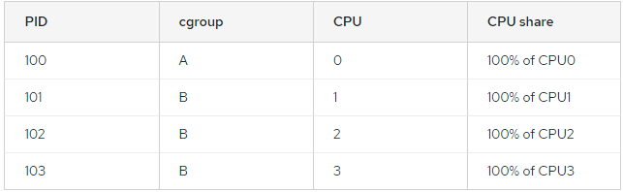
cpu
Completely Fair Scheduler (CFS):
cpu.shares:
an integer that specifies a relative share of CPU time available to the tasks in a cgroup
shares of CPU time are distributed per all CPU cores on multi-core systems.
echo 250 > /cgroup/cpu/blue/cpu.shares
echo 750 > /cgroup/cpu/red/cpu.shares
CFS does not demand equal usage of CPU
Other cgroups are allowed to borrow CPU cycles from global unusde CPU-cycles pool
actual amount of CPU time that is available to a cgroup can vary
Notes:
cpu.shares: 包含一个整数值，该整数值指定cgroup中的任务可使用的CPU时间的相对份额。For example, tasks in two cgroups that have cpu.shares set to 100 will receive equal CPU time, but tasks in a cgroup that has cpu.shares set to 200 receive twice the CPU time of tasks in a cgroup where cpu.shares is set to 100. The value specified in the cpu.shares file must be 2 or higher.
请注意，在多核系统中，CPU时间的共享是分配给每个CPU核的。在多核系统中，即使一个cgroup被限制为少于100%的CPU，它也可能使用每个单独CPU核的100%。考虑以下示例:如果cgroup A被配置为使用25%的CPU, cgroup B使用75%的CPU，那么在一个有四个核的系统上启动四个CPU密集型进程(一个在A，三个在B)会导致如下的CPU共享划分:使用相对共享来指定CPU访问对资源管理有两个影响，应该考虑：
因为CFS不要求相同的CPU使用率，所以很难预测一个cgroup将被允许使用多少CPU时间。当一个cgroup中的任务空闲且没有使用任何CPU时间时，剩余的时间将被收集到一个未使用CPU周期的全局池中。允许其他cgroup从这个池中借用CPU周期。
cgroup实际可用的CPU时间量可能会根据系统上存在的cgroup的数量而变化。如果一个cgroup的相对共享为1000，另外两个cgroup的相对共享为500，那么当所有cgroup中的进程都试图使用100%的CPU时，第一个cgroup将获得所有CPU时间的50%。但是，如果添加的另一个cgroup的相对份额为1000，则第一个cgroup只允许获得33%的CPU(其余cgroup分别获得16.5%、16.5%和33%的CPU)。

Slide 13
cpu
Real-Time scheduler (RT):
similar way to the ceiling enforcement control of the CFS for real-time tasks
take into account all available logical CPUs
cpu.rt_period_us
a period of time for how regularly a cgroup's access to CPU resources is reallocated.
cpu.rt_runtime_us:
a period of time for the longest continuous period for a cgroup having access to CPU resources
cpu.rt_runtime_us=200000; cpu.rt_period_us =000000=> 0.4s for 2 CPUs.
Notes:
RT调度器的工作方式类似于CFS的上限强制控制(更多信息，请参阅3.2.1节“CFS可调参数”)，但只限制CPU对实时任务的访问。实时任务可以访问CPU的时间是通过为每个cgroup分配一个runtime和一个period来决定的。然后，允许cgroup中的所有任务在一个运行时间内访问CPU(例如，允许cgroup中的任务每1秒运行0.1秒)。请注意，以下参数考虑了所有可用的逻辑cpu，因此使用这些参数指定的访问时间实际上要乘以cpu的数量。
cpu.rt_period_us: 该参数只适用于实时调度任务，以微秒为单位指定了cgroup对CPU资源的重新分配周期。
cpu.rt_runtime_us: 该参数只适用于实时调度任务，以微秒为单位指定cgroup内的任务访问CPU资源的连续最长时间。设置这个限制可以防止cgroup中的任务独占CPU时间。如上所述，访问时间乘以逻辑cpu的数量。For example, setting cpu.rt_runtime_us to 200000 and cpu.rt_period_us to 1000000 translates to the task being able to access a single CPU for 0.4 seconds out of every 1 second on systems with two CPUs (0.2 x 2), or 0.8 seconds on systems with four CPUs (0.2 x 4).

Slide 14
cpuacct
CPU Accounting (cpuacct) subsystem: automatic reports on CPU resources used by the tasks in a cgroup (including child groups)
three reports:
cpuacct.usage: reports the total CPU time
reset: echo 0 > /cgroup/cpuacct/cpuacct.usage (also reset cpuacct.usage_percpu)
cpuacct.stat: user and system CPU time consumed by all tasks in this cgroup
user — CPU time consumed by tasks in user mode.
system — CPU time consumed by tasks in system (kernel) mode
unit: USER_HZ
cpuacct.usage_percpu: CPU time (in nanoseconds) consumed on each CPU.
Notes:
CPU计费子系统(cpuacct)自动生成cgroup内任务(包括子组内的任务)使用CPU资源的报表。目前有三份报告
cpuacct.usage: 报告该cgroup中的所有任务(包括层次结构中较低的任务)消耗的总CPU时间(以纳秒为单位)。
cpuacct.stat: 报告该cgroup中所有任务(包括较低层的任务)所消耗的用户和系统CPU时间，方法如下:
CPU时间以USER_HZ变量定义的单位报告。
cpuacct.usage_percpu: 报告该cgroup中的所有任务(包括层次结构中较低的任务)在每个CPU上消耗的CPU时间(以纳秒为单位)。

Slide 15
cpuset
assigns individual CPUs and memory nodes to cgroups
in a separate pseudofile within the cgroup virtual file system
mandatory:
cpuset.cpus: CPUs that tasks in this cgroup are permitted to access
example: 0-2,16
cpuset.mems: memory nodes that tasks in this cgroup are permitted to access
example: 0-2,16
unmandatory:
cpuset.memory_migrate:
flag; 0(default): disable to migrate pages when cpuset.mems changing; 1: enable to migrate pages when cpuset.mems changing and try to keep relative placement.
Notes:
每个cpuset可以根据以下参数来指定，每个cgroup虚拟文件系统中的一个单独的伪文件:
cpuset.memory_migrate: 包含一个标志(0或1)，该标志指定如果cpuset.mems的值变化，内存中的页面是否应该迁移到新节点。
默认情况下，内存迁移是禁用的(0)，并且页面保持在最初分配给它们的节点上，即使该节点不再位于cpuset.mems中指定的节点中如果启用(1)，系统将页面迁移到由cpuset。mems指定的新参数内的内存节点。尽可能保持它们的相对位置例如，最初由cpuset指定的列表中第二个节点上的页面。Mems被分配给cpuset指定的新列表中的第二个节点。Mems，如果位置合适的话。

Slide 16
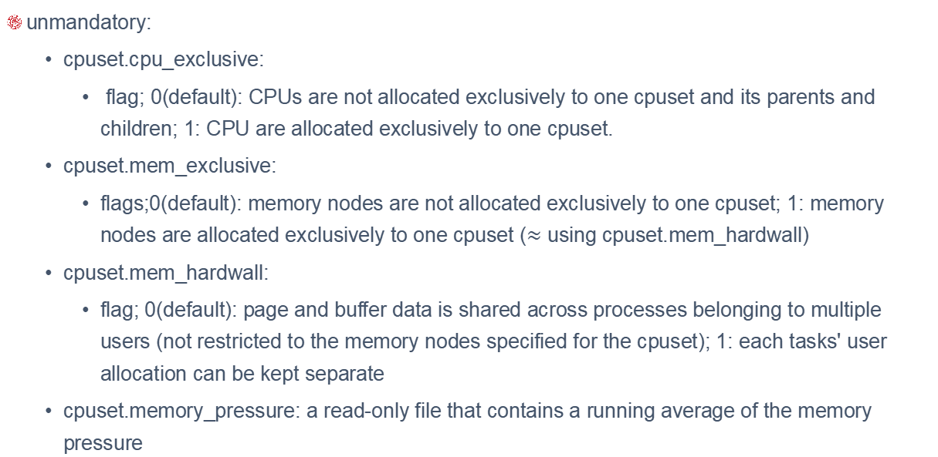
cpuset
unmandatory:
cpuset.cpu_exclusive:
flag; 0(default): CPUs are not allocated exclusively to one cpuset and its parents and children; 1: CPU are allocated exclusively to one cpuset.
cpuset.mem_exclusive:
flags;0(default): memory nodes are not allocated exclusively to one cpuset; 1: memory nodes are allocated exclusively to one cpuset ($≈$ using cpuset.mem_hardwall)
cpuset.mem_hardwall:
flag; 0(default): page and buffer data is shared across processes belonging to multiple users (not restricted to the memory nodes specified for the cpuset); 1: each tasks' user allocation can be kept separate
cpuset.memory_pressure: a read-only file that contains a running average of the memory pressure

Slide 17
cpuset
unmandatory:
cpuset.memory_pressure:
a read-only file that contains a running average of the memory pressure (0 if cpuset.memory_pressure_enabled=0), the rate at which processes attempt to free in-use memory: attempts to reclaim memory per second x 1000.
cpuset.memory_pressure_enabled:
flag; 0(default): do not report cpuset.memory_pressure; 1: report cpuset.memory_pressure
cpuset.memory_spread_page:
flag; 0(default): do not spread memory pages for buffers evenly through node memory; but place them on the same node on which the process that created them is running.
cpuset.memory_spread_slab:
flag,0(default): do not spread kernel slab caches (for file input/output) evenly

Slide 18
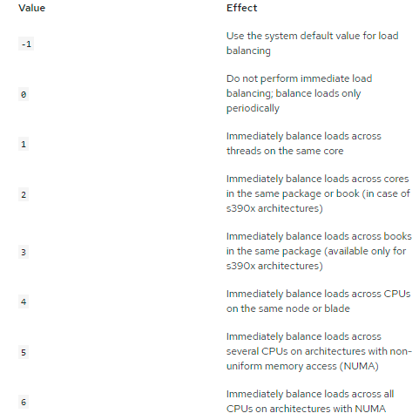
cpuset
unmandatory:
cpuset.sched_load_balance:
flag; 1(default): the kernel balances loads by moving processes from overloaded CPUs to less heavily used CPUs; 0: do not balance loads across the CPUs
cpuset.sched_relax_domain_level:
an integer between -1 and a small positive value; the width of the range of CPUs across which the kernel should attempt to balance loads

Slide 19
devices
allows or denies access to devices by tasks in a cgroup
devices.allow
specifies devices to which tasks in a cgroup have access, has four fields:
type:
a — applies to all devices, both character devices and block devices
b — specifies a block device
c — specifies a character device
major, minor: device node numbers specified by Linux Allocated Devices
for example, major=8: Small Computer System Interface (SCSI) disk drives; minor=1: first partition on the first SCSI disk drive => 8:1 means /dev/sda1
access:
r — allows tasks to read from the specified device
w — allows tasks to write to the specified device
m — allows tasks to create device files that do not yet exist
Notes:
major和minor为“Linux已分配设备”指定的设备节点号。主号和副号用冒号分隔。例如，主编号8表示SCSI磁盘驱动器，副编号1表示第一个SCSI磁盘驱动器上的第一个分区;因此8:1完全指定了这个分区，对应于/dev/sda1的文件系统位置
*”表示所有主设备节点或所有次要设备节点，例如“9:*”表示所有RAID设备，“*:*”表示所有设备。

Slide 20
devices
devices.deny
specifies devices that tasks in a cgroup cannot access. The syntax of entries is identical with devices.allow
devices.list:
reports the devices for which access controls have been set for tasks in this cgroup.
Notes:
major和minor为“Linux已分配设备”指定的设备节点号。主号和副号用冒号分隔。例如，主编号8表示SCSI磁盘驱动器，副编号1表示第一个SCSI磁盘驱动器上的第一个分区;因此8:1完全指定了这个分区，对应于/dev/sda1的文件系统位置
*”表示所有主设备节点或所有次要设备节点，例如“9:*”表示所有RAID设备，“*:*”表示所有设备。

Slide 21
freezer
suspends or resumes tasks in a cgroup
freezer.state: available in non-root cgroups
FROZEN: tasks in the cgroup are suspended
FREEZING:the system is in the process of suspending tasks in the cgroup
THAWED:tasks in the cgroup have resumed
suspend a specific process:
Move that process to a cgroup in a hierarchy which has the freezer subsystem attached to it
Freeze that particular cgroup to suspend the process contained in it
It is not possible to move a process into a suspended (frozen) cgroup.
Notes:
请注意，当FROZEN和thawed值可以被写入到freezer中。状态，FREEZING不能写，只能读。

Slide 22
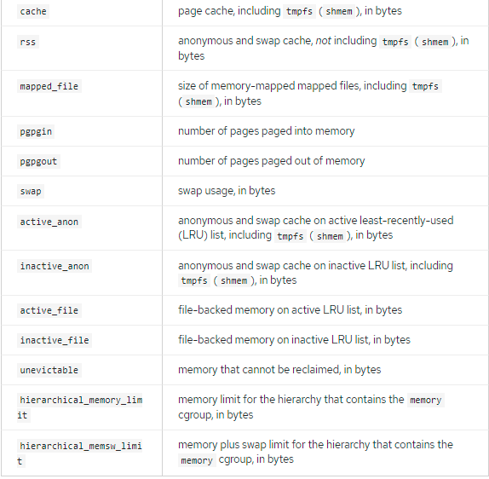
memory
generates automatic reports on memory resources used by the tasks in a cgroup
sets limits on memory use of those tasks
For each physical page, memory subsystem consumes 40 bytes (set cgroup_disable=memory in /boot/grub/grub.conf)
memory.stat: a wide range of memory statistics
Notes:
默认情况下，内存子系统在x86_64系统上每个物理页使用40字节的内存。即使在任何层次结构中没有使用内存，也会消耗这些资源。如果不打算使用内存子系统，可以禁用它以减少内核的资源消耗。要永久禁用内存子系统，请以root身份打开/boot/grub/grub.conf配置文件，并将以下文本附加到以kernel关键字开头的行.
此外，除了hierarchical_memory_limit和hierarchical_memsw_limit之外，每个文件都有一个前缀为total_的对应文件，不仅报告cgroup，还报告它的所有子组。例如，swap报告cgroup的swap使用情况，total_swap报告cgroup及其所有子组的总swap使用情况。
active_anon + inactive_anon = anonymous memory + file cache for tmpfs + swap cache
Therefore, active_anon + inactive_anon ≠ rss, because rss does not include tmpfs.
active_file + inactive_file = cache - size of tmpfs

Slide 23
memory
memory.usage_in_bytes
reports the total current memory usage by processes in the cgroup (in bytes).
memory.memsw.usage_in_bytes
reports the sum of current memory usage plus swap space used by processes in the cgroup
memory.max_usage_in_bytes
reports the maximum memory used by processes in the cgroup (in bytes).
memory.memsw.max_usage_in_bytes
reports the maximum amount of memory and swap space used by processes in the cgroup
Notes:
默认情况下，内存子系统在x86_64系统上每个物理页使用40字节的内存。即使在任何层次结构中没有使用内存，也会消耗这些资源。如果不打算使用内存子系统，可以禁用它以减少内核的资源消耗。要永久禁用内存子系统，请以root身份打开/boot/grub/grub.conf配置文件，并将以下文本附加到以kernel关键字开头的行

Slide 24
memory
memory.limit_in_bytes
sets the maximum amount of user memory (including file cache)
echo 1G > /cgroup/memory/lab1/memory.limit_in_bytes
memory.memsw.limit_in_bytes
sets the maximum amount for the sum of memory and swap usage
memory {
memory.limit_in_bytes = 1G;
memory.memsw.limit_in_bytes = 1G;}
memory.failcnt:
reports the number of times that the memory limit has reached memory.limit_in_bytes.
memory.memsw.failcnt
number of times that memory plus swap space limit has reached memory.memsw.limit_in_bytes
Notes:
memory.limit_in_bytes: 设置用户内存的最大数量(包括文件缓存)。如果没有指定单位，则将值解释为字节。但是，也可以使用后缀来表示更大的单位——k或k表示千字节，m或m表示兆字节，g或g表示千兆字节。例如，要将限制设置为1g，请执行
cannot use memory.limit_in_bytes to limit the root cgroup; you can only apply values to groups lower in the hierarchy.
Write -1 to memory.limit_in_bytes to remove any existing limits.
在设置memory.memsw.limit_in_bytes之前应设置memory.limit_in_bytes参数。以相反的顺序尝试这样做会导致错误。这是因为memory.memsw.limit_in_bytes。只有在用尽所有内存限制(以前在memory. limit_in_bytes中设置的)后，才可用。
Consider the following example: setting memory.limit_in_bytes = 2G and memory.memsw.limit_in_bytes = 4G for a certain cgroup will allow processes in that cgroup to allocate 2 GB of memory and, once exhausted, allocate another 2 GB of swap only. The memory.memsw.limit_in_bytes parameter represents the sum of memory and swap. Processes in a cgroup that does not have the memory.memsw.limit_in_bytes parameter set can potentially use up all the available swap (after exhausting the set memory limitation) and trigger an Out Of Memory situation caused by the lack of available swap.

Slide 25
memory
memory.soft_limit_in_bytes
enables flexible sharing of memory
echo 256M > /cgroup/memory/lab1/memory.soft_limit_in_bytes
reclaiming memory for balancing between memory cgroups
memory.force_empty
flag, 0: empties memory of all pages used by tasks in the cgroup
memory.swappiness:
tendency of the kernel to swap out process memory used by cgroup instead of reclaiming pages from the page cache.
60: default value; >60: increasing swap-out tendency; <60: decreasing swap-out tendency.
100: > 100 permit to swap-out part of address space.
0: do not precent swap-out (global virtual memory management logic -> mlock())
Notes:
memory.soft_limit_in_bytes: enables flexible sharing of memory
memory.force_empty: If memory cannot be freed, it is moved to a parent cgroup if possible. Use the memory.force_empty parameter before removing a cgroup to avoid moving out-of-use page caches to its parent cgroup
memory.swappiness: 设置倾向： 换出cgroup中任务使用的进程内存，而不是从页面缓存中回收页面。这与系统整体/proc/sys/vm/swappiness中设置的趋势是相同的，计算方式也是相同的。缺省值为60。低于60的值会减少内核换出进程内存的倾向。大于60的值会增加内核换出进程内存的倾向如果值大于100，则允许内核交换出cgroup中进程地址空间的一部分页面。注意，值为0并不会阻止进程内存被换出;当系统内存不足时，仍可能发生换出。因为全局虚拟内存管理逻辑（global virtual memory management logic）不读取cgroup值。To lock pages completely, use mlock() instead of cgroups.
You cannot change the swappiness of the following groups:
the root cgroup, which uses the swappiness set in /proc/sys/vm/swappiness.
a cgroup that has child groups below it.

Slide 26
memory
memory.swappiness:
can not for root cgroup (using /proc/sys/vm/swappiness) and cgroup having child groups
memory.move_charge_at_immigrate
Charging: giving a penalty to cgroups which access shared pages too often
allows moving charges associated with a task along with task migration
echo 1 > /cgroup/memory/lab1/memory.move_charge_at_immigrate (enabled)
echo 0 > /cgroup/memory/lab1/memory.move_charge_at_immigrate (disabled)
moved only when the moved task is a leader of a thread group
memory.use_hierarchy
flag, 0(default): subsystem does not reclaim memory from a task's children; 1: reclaims memory from the children of and process that exceeds its memory limit
memory.oom_control
Notes:
memory.move_charge_at_immigrate: 当任务从一个cgroup迁移到另一个cgroup时，默认情况下不会移动这些惩罚，也称为收费。从原来的cgroup中分配的页面仍然对它收费;当页面被释放或回收时，费用将被取消。the pages associated with a task are taken from the old cgroup and charged to the new cgroup
只有当被移动的任务是线程组的leader时，才会移动费用。如果目标cgroup中的任务没有足够的内存，则尝试回收内存。如果回收不成功，任务迁移将中止。

Slide 27
memory
memory.oom_control
flag; 0(default): consume more memory than allowed are immediately killed by the OOM killer.
echo 1 > /cgroup/memory/lab1/memory.oom_control ( paused until additional memory is freed)
reports the OOM status of the current cgroup under the entry: under_oom (1 for OOM)
Notes:
memory.move_charge_at_immigrate: 当任务从一个cgroup迁移到另一个cgroup时，默认情况下不会移动这些惩罚，也称为收费。从原来的cgroup中分配的页面仍然对它收费;当页面被释放或回收时，费用将被取消。the pages associated with a task are taken from the old cgroup and charged to the new cgroup
只有当被移动的任务是线程组的leader时，才会移动费用。如果目标cgroup中的任务没有足够的内存，则尝试回收内存。如果回收不成功，任务迁移将中止。

Slide 28
net_cls
tags network packets with a class identifier (classid)
allows the Linux traffic controller (tc) to identify packets originating from a particular cgroup
traffic controller assign different priorities to packets from different cgroups.
net_cls.classid:
read from the net_cls.classid file (read in decimal format, write in hexadecimal format.)
echo 0x100001 > /cgroup/net_cls/red/net_cls.classid
cat /cgroup/net_cls/red/net_cls.classid //1048577
Notes:
net_cls.classid包含指示流量控制句柄的单个值.从net_cls中读取classid的值。Classid文件以十进制格式显示，而要写入文件的值期望以十六进制格式显示。例如，0x100001表示以ip实用程序使用的格式按惯例写成10:1的句柄。net_cls。分类文件，它将由数字1048577表示。
这些句柄的格式为:0xAAAABBBB，其中AAAA为十六进制的主号，BBBB为十六进制的副号。你可以省略任何前导零;0x10001与0x00010001相同，表示1:1。下面是在net_cls中设置10:1句柄的示例。classid文件:
参考tc的手册页了解如何配置流量控制器来使用net_cls添加到网络数据包的句柄

Slide 29
net_prio
provides a way to dynamically set the priority of network traffic per each network interface for applications within various cgroups
a number assigned to network traffic and used internally by the system and network devices
differentiate packets that are sent, queued, or dropped
tc command may be used to set a network's priority
assign a process to a specific cgroup which defines the priority of outgoing traffic on a given network interface
net_prio.prioidx: read-only file which contains a unique integer value
net_prio.ifpriomap: <network_interface> <priority>
cat /cgroup/net_prio/iscsi/net_prio.ifpriomap: eth0 5 eth1 4 eth2 6
echo "eth0 5" > /cgroup/net_prio/iscsi/net_prio.ifpriomap
Notes:
网络的优先级是分配给网络流量的号码，由系统和网络设备内部使用。网络优先级用于区分发送、排队或丢弃的数据包。
net_prio.prioidx: 一个只读文件，它包含一个唯一的整数值，内核使用这个整数值作为这个cgroup的内部表示。
net_prio.ifpriomap: 包含分配给来自该组中的进程并在不同接口上离开系统的流量的优先级的映射这个映射由<network_interface> <priority>形式的对列表表示

Slide 30
ns
provides a way to group processes into separate namespaces
In a particular namespace, processes interacts with each other but are isolated from processes running in other namespaces
containers when used for operating-system-level virtualization
Notes:
ns子系统提供了一种将进程分组到单独名称空间的方法。在特定的名称空间中，进程可以相互交互，但与运行在其他名称空间中的进程隔离。当用于操作系统级虚拟化时，这些单独的名称空间有时称为容器

Slide 31
perf_event
all cgroups in attached hierarchy can be used to group processes and threads which can then be monitored with the perf tool
opposed to monitoring each process or thread separately or per-CPU
perf: low-level and light-weight performance monitoring tool.
Notes:
ns子系统提供了一种将进程分组到单独名称空间的方法。在特定的名称空间中，进程可以相互交互，但与运行在其他名称空间中的进程隔离。当用于操作系统级虚拟化时，这些单独的名称空间有时称为容器

